Slide 1
OpenRewrite in a Nutshell
Scaling Upgrades with Practical Insights
Simon Gartner
02.06.2025

Slide 2
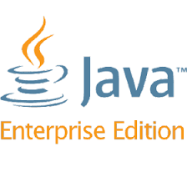




Frameworks we’ve used
3
2
1
Notes:
Most of us use some kind of framework. These had older versions
(eg. JEE < 9, Junit 4, Quarkus 2, Spring <3, Log4j)

Slide 3


Upgraded to…
6
3
2
Notes:
Now we (hopefully) us newer versions. These Frameworks often have major upgrades
Many manual changes?
How do we manage this?
We had to perform large upgrades in the past

Slide 4
A large upgrade: Jakarta EE 9
// javax.inject.Inject -> jakarta.inject.Inject
// javax.naming.InitialContext -> javax.naming.InitialContext
Notes:
One Example for a large need for migration is JEE 8 to Jakarta EE 9 / JBoss EAP-7 to EAP-8.
JEE Classes changed namespace from javax.* to jakarta.*,
Not everything inside javax.* is jakarta

Slide 5
A large upgrade: Jakarta EE 9
javax.persistence-api
javax.servlet-api
Application
javax.ws.rs-api
hibernate-core
javax.persistence-api
Notes:
Pains with JBoss EAP-Upgrade:
Dependencies changed from javax.* to jakarta.*
all dependencies shipping javax.*got to change

Slide 6
Upgrading manually - A tedious task
// Time consuming
// Error prone
// Not fun
Notes:
One Example for a large need for migration is JEE 8 to Jakarta EE 9 / JBoss EAP-7 to EAP-8.
JEE Classes changed namespace from javax.* to jakarta.*,
Not everything inside javax.* is jakarta

Slide 7

Upgrading manually - Stop the world
update
main
feature
Notes:
Developing while performing the upgrade often results in large merge conflicts.
Alternative: Stop the world - Stopping development, no new features are implemented while updating.

Slide 8

Upgrading manually - Repeated effort
↻
Spring Application
1
Spring Application
2
Spring Application
3
↻
↻
↻
Notes:
Often many applications using the same framework inside an organization.
Manual upgrades mean repeated effort.

Slide 9

And that’s how OpenRewrite got born!
↻
Spring Application
1
Spring Application
2
Spring Application
3
Notes:
OpenRewrite was created inside Netflix
Idea was to minimalize repeated effort.
Also solves the problems from before.
OpenRewrite defines Recipes which perform automated transformations upon your code.
Custom Recipes vs. Composite Recipes:
Custom: Own Java Impl
Composite: List of recipes 2 be executed on ur code

Slide 10
About text replacements
public void example() {
Type x = new Type();
x.doSomething();
OtherType y = new OtherType();
y.doSomething();
}
public void example() {
Type x = new Type();
x.doNothing();
OtherType y = new OtherType();
y.doSomething();
}
Notes:
Well, I can speed it up using text replacements.
Two methods called doSomething, but i only want to change the method of “OtherType”.
Can i rely on instances having the same name?
Regex often complicated
Whitespaces, Line-Breaks, etc. can matter.

Slide 11

About LLMs
Notes:
LLMs are great to get introspective in a class or migrate a small bunch of files but:
Not deterministic: LLMs might slip through some errors
Not traceable: You don’t know why a LLM touched some pieces of code
Not allowed sometimes: Some orgs disallow sharing code, especially into foreign countries
LLMs + OpenRewrite is something that happens. Rec

Slide 12
Formats supported by OpenRewrite
// Java
// XML / Maven
// Groovy / Gradle
// JSON
// YAML
// Properties
// …
Notes:
Especially Java and everything around java.
OpenRewrite also knows Maven-Metadata for pom.xml and Gradle-Metadata for build.gradle files.

Slide 13
Recipe Catalog
// List of official Recipes by Moderne / Open Source
https://docs.openrewrite.org/recipes/java/migrate/jakarta/jakartaee11
Notes:
Recipe = Main unit of OpenRewrite functionality.
Can be one small building block (changing a maven dependency, renaming a class)
or whole migrations (quarkus 2 -> 3, java ee -> jakarta ee)
[Show recipe in link, show around the website interface, recipes list
Execute recipe, explain maven-plugin config, show run vs. dry-run
solution1:
- Rezept einfach aus dem link kopieren (in maven im plugin unter <config><activeRecipes><recipes> angegeben)]

Slide 14
Composite Recipes

Slide 15
Another Recipe
https://docs.openrewrite.org/recipes/maven/changedependencygroupidandartifactid
Notes:
This recipe uses arguments - it has to be declared in a composite recipe
(rewrite-maven-plugin can’t take arguments for recipes)
We use it to upgrade the org.jboss.spec jax-rs dependency to jakarta.
[Show recipe in link,
create rewrite.yml with the recipe in link (copy it),
copy JakartaEE10 recipe to rewrite.yml as first recipe
change the name to com.gepardec.JakartaEE11,
solution2]

Slide 16
Other Recipes
// UpgradeDependency
// ChangePropertyValue
// ChangeType
// ReplaceAnnotation
// JakartaEE10
// Slf4jToLog4j

Slide 17
Impact analysis
Notes:
Before doing an upgrade you want to be able to estimate the scope of the upgrade.
Especially unknown applications or usages across many applications / services.
-> You can use recipes not only to write, also to read (and compile data from) your code.

Slide 18
DataTables
// List of Recipes that produce DataTables:
https://docs.openrewrite.org/reference/recipes-with-data-tables
// (includes mutating recipes that also produce custom DataTables)
// DataTables example:
https://docs.openrewrite.org/recipes/core/languagecomposition
Notes:
DataTables:
Generate tabular data of your code. Can be used to create visualizations later.
Large comprehensive list of DataTables recipes or good API for creating your own
Not used to compile single, comprehensive metrics.
Rather a per file / per package kinda units.
[Show dataTable recipe in second link.
Copy the example (replace the active recipe to the recipe in the link, add the plugin dependency, add <exportDatatables>true</exportDatatables>)
Run it
Show custom and default data tables
solution3]

Slide 19
Framework Migrations
Notes:
Now we look how to tackle for example a Jakarta EE 10 Upgrade

Slide 20



Transformer
up2date
main
feature
Notes:
Transformer-style:
We have one Transformer “Script”, OpenRewrite in this case, which is created to perform the whole upgrade
Therefore developers can still develop features and a recipe for jakarta upgrade runs and transforms these new features to.
Most of the new changes are in some kind of same style, therefore can be transformed like the other files.
Merged in the end, partially, etc. -> minimized stopped world

Slide 21


Prerequisites for Framework Migrations
// Transitive
dependencies in
controlled code?
// Ensure a good test
coverage
// Clean up to ease
automation
Notes:
These Prerequisites are important, because it helps the automation to work and to ensure it works.
(transitive dependencies) Dependencies to components that should be migrated before?
E.g. shared libraries that use the framework’s API?
Ensure a good test coverage
Clean up for automated migrations:
Used dependencies should be declared
Delete unused code
Unused Dependencies make higher effort
Cleanup Module References

Slide 22

Automating Framework Migrations
Compile
Unit Tests
Deployment
IT Tests
Notes:
One recipe is responsible for the entire migration of an framework.
To define our criteria, we want our code to successfully compile and build using jakarta.* namespace.
First we run a large migration recipe (like Jakarta EE 11) and try to compile afterwards.
If it fails, we look up why and add a recipe to correct the error to the large composite recipe.
Repeat that.
After that, all JUnit Tests should run, successful deployment+configuration on your environment (in our case JBoss EAP-8), successful IT-Tests / System tests

Slide 23
Single Cases
Q: Should I make the effort to integrate specific cases even if they only have one occurrence?
A: Yes! But keep it simple! For example, you could do:
FindAndReplace
Replace entire files
Notes:
Sometimes my colleagues ask if it makes sense to integrate a solution
to a specific problem into the recipe.
Is it too much of a hustle?
No, but integrate it in a simple form:
FindAndReplace: Simple Text Replacement across a specified set of files
Replace entire files (custom recipe)

Slide 24
Custom Recipes
Notes:
If the cases repeats a whole more, custom recipes could make sense.

Slide 25
Interface transformation
request
.getMetadata()
.setTenantId(“1”);
Metadata meta = ObjectFactory.createMetadata();
JaxbElement<String> tenantId =
ObjectFactory
.createMetadataTenantId(“1”);
meta.setTenantId(tenantId);
request.setMetadata(meta);
Notes:
For example:
Old: Request for a old binary protocol. Uses lazy loading and has no further requirements from the API.
New: Same request using SOAP - generated classes. Object-Factory needed to create instances and no lazy loading.
A large amount of occurrences,
binary protocol had to be replaced with soap
because no maintenance for a long time.
Written a recipe!

Slide 26
Lossless Semantics Tree (LST)
\---J.ClassDeclaration
|---J.Modifier | "public"
|---J.Identifier | "Main"
\---J.Block
\-------J.MethodDeclaration | "MethodDeclaration{com.gepardec.Main}"
|---J.Modifier | "public"
|---J.Modifier | "static"
|---J.Primitive | "void"
|---J.Identifier | "main"
|-----------J.VariableDeclarations | "String[] args"
\---J.Block
\-------J.MethodInvocation | "System.out.println("Hello world!")"
|-------J.FieldAccess | "System.out"
|---J.Identifier | "println"
\-----------J.Literal | ""Hello world!""
Notes:
Now, in Order that a recipe can function:
OpenRewrite generates a LST for every File.
This is a LST for Hello World.
AST = Abstract Syntax Tree -> Code Elements stored in a simplified Tree Structure
(Class have Methods, Methods have Bodies, Bodies have Statements, …)
L = Lossless -> No formatting is lost = Whitespaces, Comments
S = Semantic -> OpenRewrite attributes type model to each LST node. -> Every Statement is typed according to Maven/Gradle dependencies.
T = Tree
LST for Hello World:
Class Declaration with Identifier “Main”
Method Declaration with Identifier “main”, return type “void” and Arguments “String[] args”
Method invocation -> Print “Hello World”

Slide 27
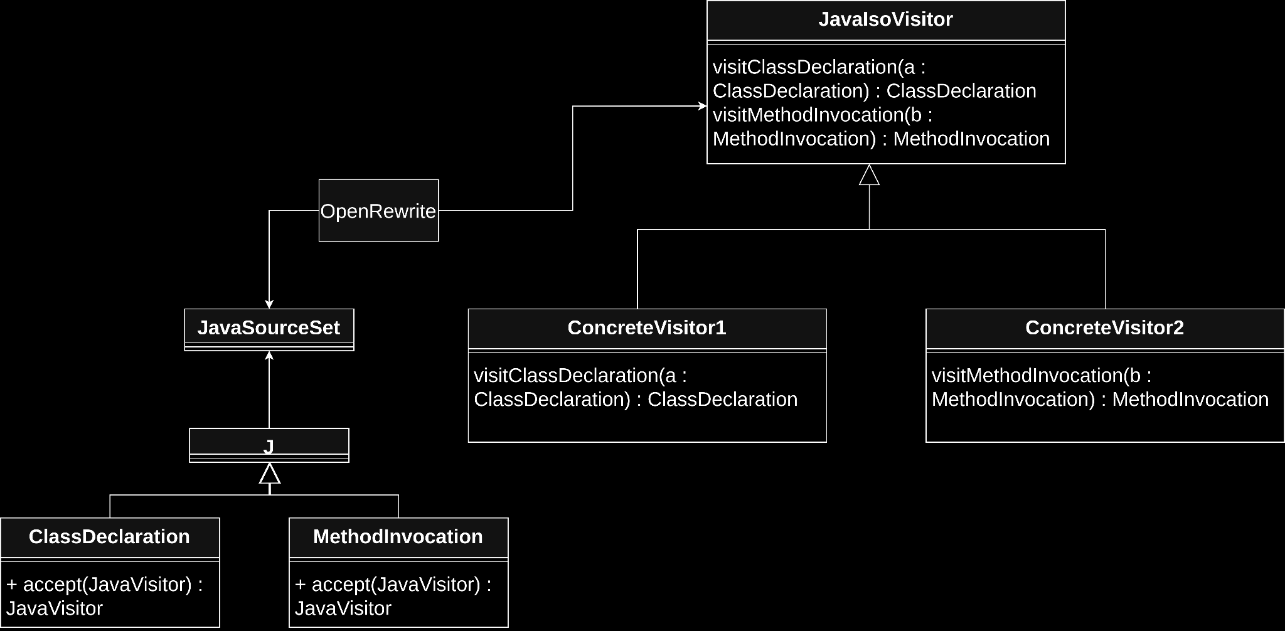
Visitor Pattern
Notes:
Visitor Pattern:
OpenRewrite iterates once through all LSTs of your code.
You can add one or more visitors to its execution (through recipes)
A visitor implements one or more visit*-methods for a specific syntax type
Every LST type calls it’s specific visit*-Method

Slide 28
Example for custom recipes
Notes:
Example for writing a custom recipe
Show tests in custom-recipes submodule and explain. Type#doSomething has to be changed, the rest doesn’t.
Then implement a recipe for this test:
Filter out methods that don’t have the name “doSomething”
Filtre out methods of other types than “Type”
Mutate method (With: nested inside Identifier, JavaTemplate: com.gepardec.Type stub needed.)
Solution5

Slide 29
Interface transformation
request
.getMetadata()
.setTenantId(“1”);
Metadata meta = ObjectFactory.createMetadata();
JaxbElement<String> tenantId =
ObjectFactory
.createMetadataTenantId(“1”);
meta.setTenantId(tenantId);
request.setMetadata(meta);
Notes:
How did i solve my special use case from before?

Slide 30
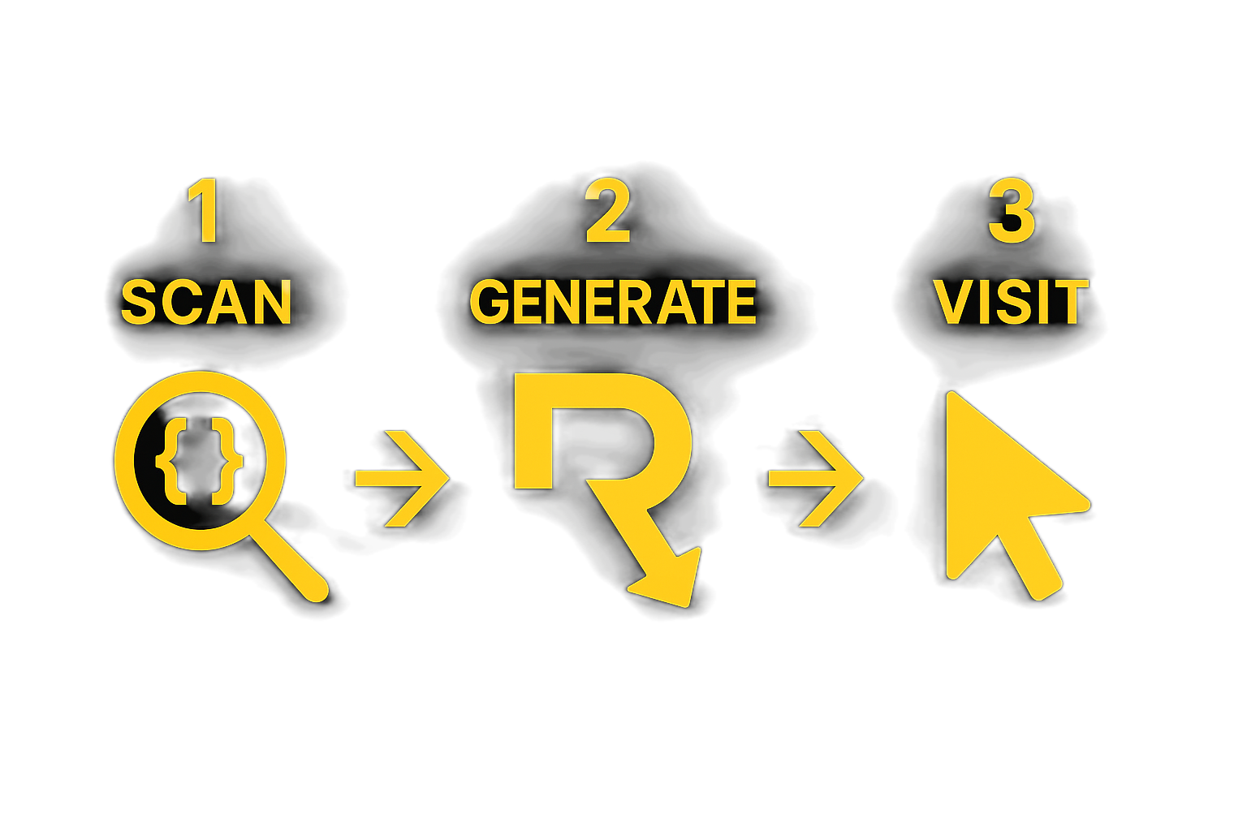
Scanning Recipe
// Lookup DTO in tree and add initialisations + nested setters
// Scan DTO hierarchies and store as Tree
Notes:
Scanning Recipe to be used when encountering the problem with the interface types.
Splits up the OpenRewrite execution in 2 cycles.
(LST gets cycled through 2 times)
1. Extracting info and 2. Making changes
Scan: Extract information from source code. In my case i build a tree structure containing the necessary info about the structure of the binary DTOs.
Generate: If you want to create new source files. Not required and not used in this example.
Visit (mutate): Make changes based on the infos of the scan. In my case constructing the new dto access statements and replacing the old.

Slide 31
Quality Criterias for Recipes
// Type attribution
// Idempotency
// Atomicity
Notes:
Quality criterias are:
Type attribution: All recipes have to inject LST Elements that have correct type Metadata (not Empty)
or subsequent recipes depending on that info might fail / not work correctly
Idempotency: Often iterative development when executing your recipes. If a recipe already made a change
it shouldn’t repeat it in the most cases.
Atomicity: Try to split up your Recipes into smaller ones, because they grow complexity really fast

Slide 32
Learning to write Recipes
// https://docs.openrewrite.org/authoring-recipes
// https://docs.moderne.io/user-documentation/community-office-hours/
// https://app.moderne.io/recipes/org.openrewrite.java.search.FindMethods
// https://join.slack.com/t/rewriteoss/shared_invite/zt-1ihfggp2a-glIit_aXJnhHAdv_0uzwow
Notes:
Writing recipes is:
Bit of an headache
Slim documentation
Steep learning curve
Sometimes really useful
-> in cases where you need transformations specific to your software’s conventions, configurations or architecture.
link OpenRewrite Docs on how to write recipes (at least to start)
Moderne CodeRemix Weekly - YouTube Playlist by official Moderne devs that includes guides, insights and new feature explanations
Moderne Platform Public Instance - Apply all recipes against the OpenRewrite Repositories.
FindMethods to lookup usages of a method in question -> Examples
OpenRewrite Slack Channel -> Very fast responses to questions

Slide 33
Sharing Recipes

Slide 34
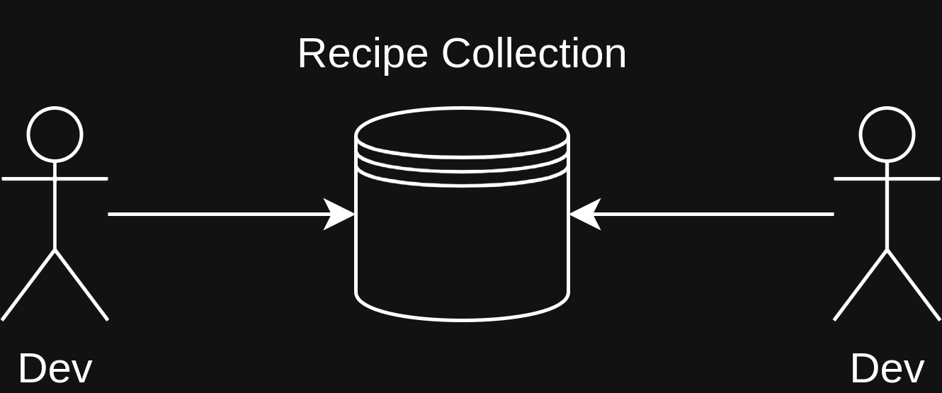
In-House Toolbox
Notes:
Recipes can be bundled into artifacts, these can be included via rewrite-maven-plugin.
Recipe Collection can include:
Small Building Blocks like DeleteClass, ReplaceSourceFile
Large migration recipes like MigrateJersey (to be jakarta compatible)
Other devs can access recipes here.
This works conceptually like a toolbox, where different recipes can be shared with developers that may encounter similar problems.

Slide 35
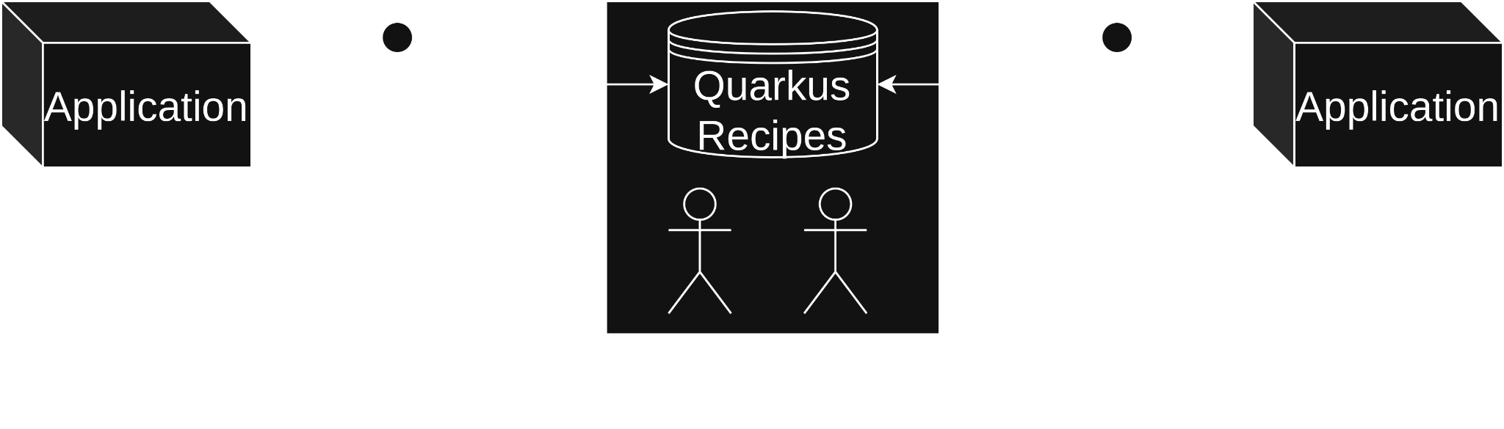
Library-oriented
Notes:
The other perspective is from the viewpoint of framework / library developers.
A development team from a library can provide migration recipes when releasing a new version.
For example Quarkus does this.
Quarkus provides the Maven goal quarkus:update, which performs (most) necessary migrations up to the specified version. (Per default: newest). This uses OpenRewrite in the background.
Alternatively, this can also be externalised by a team specialised in writing Recipes. E.g. Spring upgrades and Jakarta Upgrades are available in the OpenRewrite Repositories.
Also applicable to InHouse libraries.

Slide 36

Auto Update Service
// Renovate finds new Updates
// OpenRewrite migrates to a new update
Notes:
We as Gepardec have a offering called “Auto Update Service”.
Used for continuously upgrading software versions and performing migrations.
Renovate scans for new versions and invokes OpenRewrite to perform the upgrade to a new version.
(e.g. quarkus:update for new quarkus versions)
After OpenRewrite made its changes, Renovate creates a PR and executes automatic tests.
Tests results are shown -> Dev can make fixes if error occurs

Slide 37



